Slide 1
FORM
DESIGN
FUNCTION

Slide 2
“All scientific knowledge we have in this world [...] is as an island in the sea of mystery.”¹ ”The larger the island of knowledge, the longer the shoreline of wonder”²
— 1. Chet Raymo, Skeptics and True Believers: The Exhilarating Connection between Science and Religion.
— 2. Ralph W. Sockman cf. Alberto Cairo,The Truthful Art: Data, Charts, and Maps for Communication

Slide 3

Island of
Knowledge
Shoreline of Wonder
Sea of
Mysteries

Slide 4
RELATIVE
POSITIONS

Slide 5



User’s perspective
Sea of
Mysteries
Data Visualization
Shoreline of Wonder
User
Designer
Island of
Knowledge

Slide 6
Designer’s perspective
Sea of
Mysteries
Shoreline of Wonder
Data Visualization
Designer
User
Island of
Knowledge

Slide 7
Designer’s perspective
Sea of
Mysteries
Mental
imagery
Graphical
Perception
Shoreline of Wonder
DECODING
Data Visualization
ENCODING
Designer
User
Island of
Knowledge

Slide 8
Mental imagery
“Highly structured representations [that] can emerge independently of retinal input, allowing the visual system to reason coherently about the visual environment, even when there is nothing to see.”
—Jesse Breedlove et al., Generative Feedback Explains Distinct Brain Activity Codes for Seen and Mental Images
Current Biology 30, 2211–2224 June 22, 2020. Elsevier Inc. https://doi.org/10.1016/j.cub.2020.04.014
Notes:
What would you think is the fastest way to encode visual imagery? That is, what is the fastest way to represent, to the outside world an image that it is in your brain?

Slide 9


Slide 10
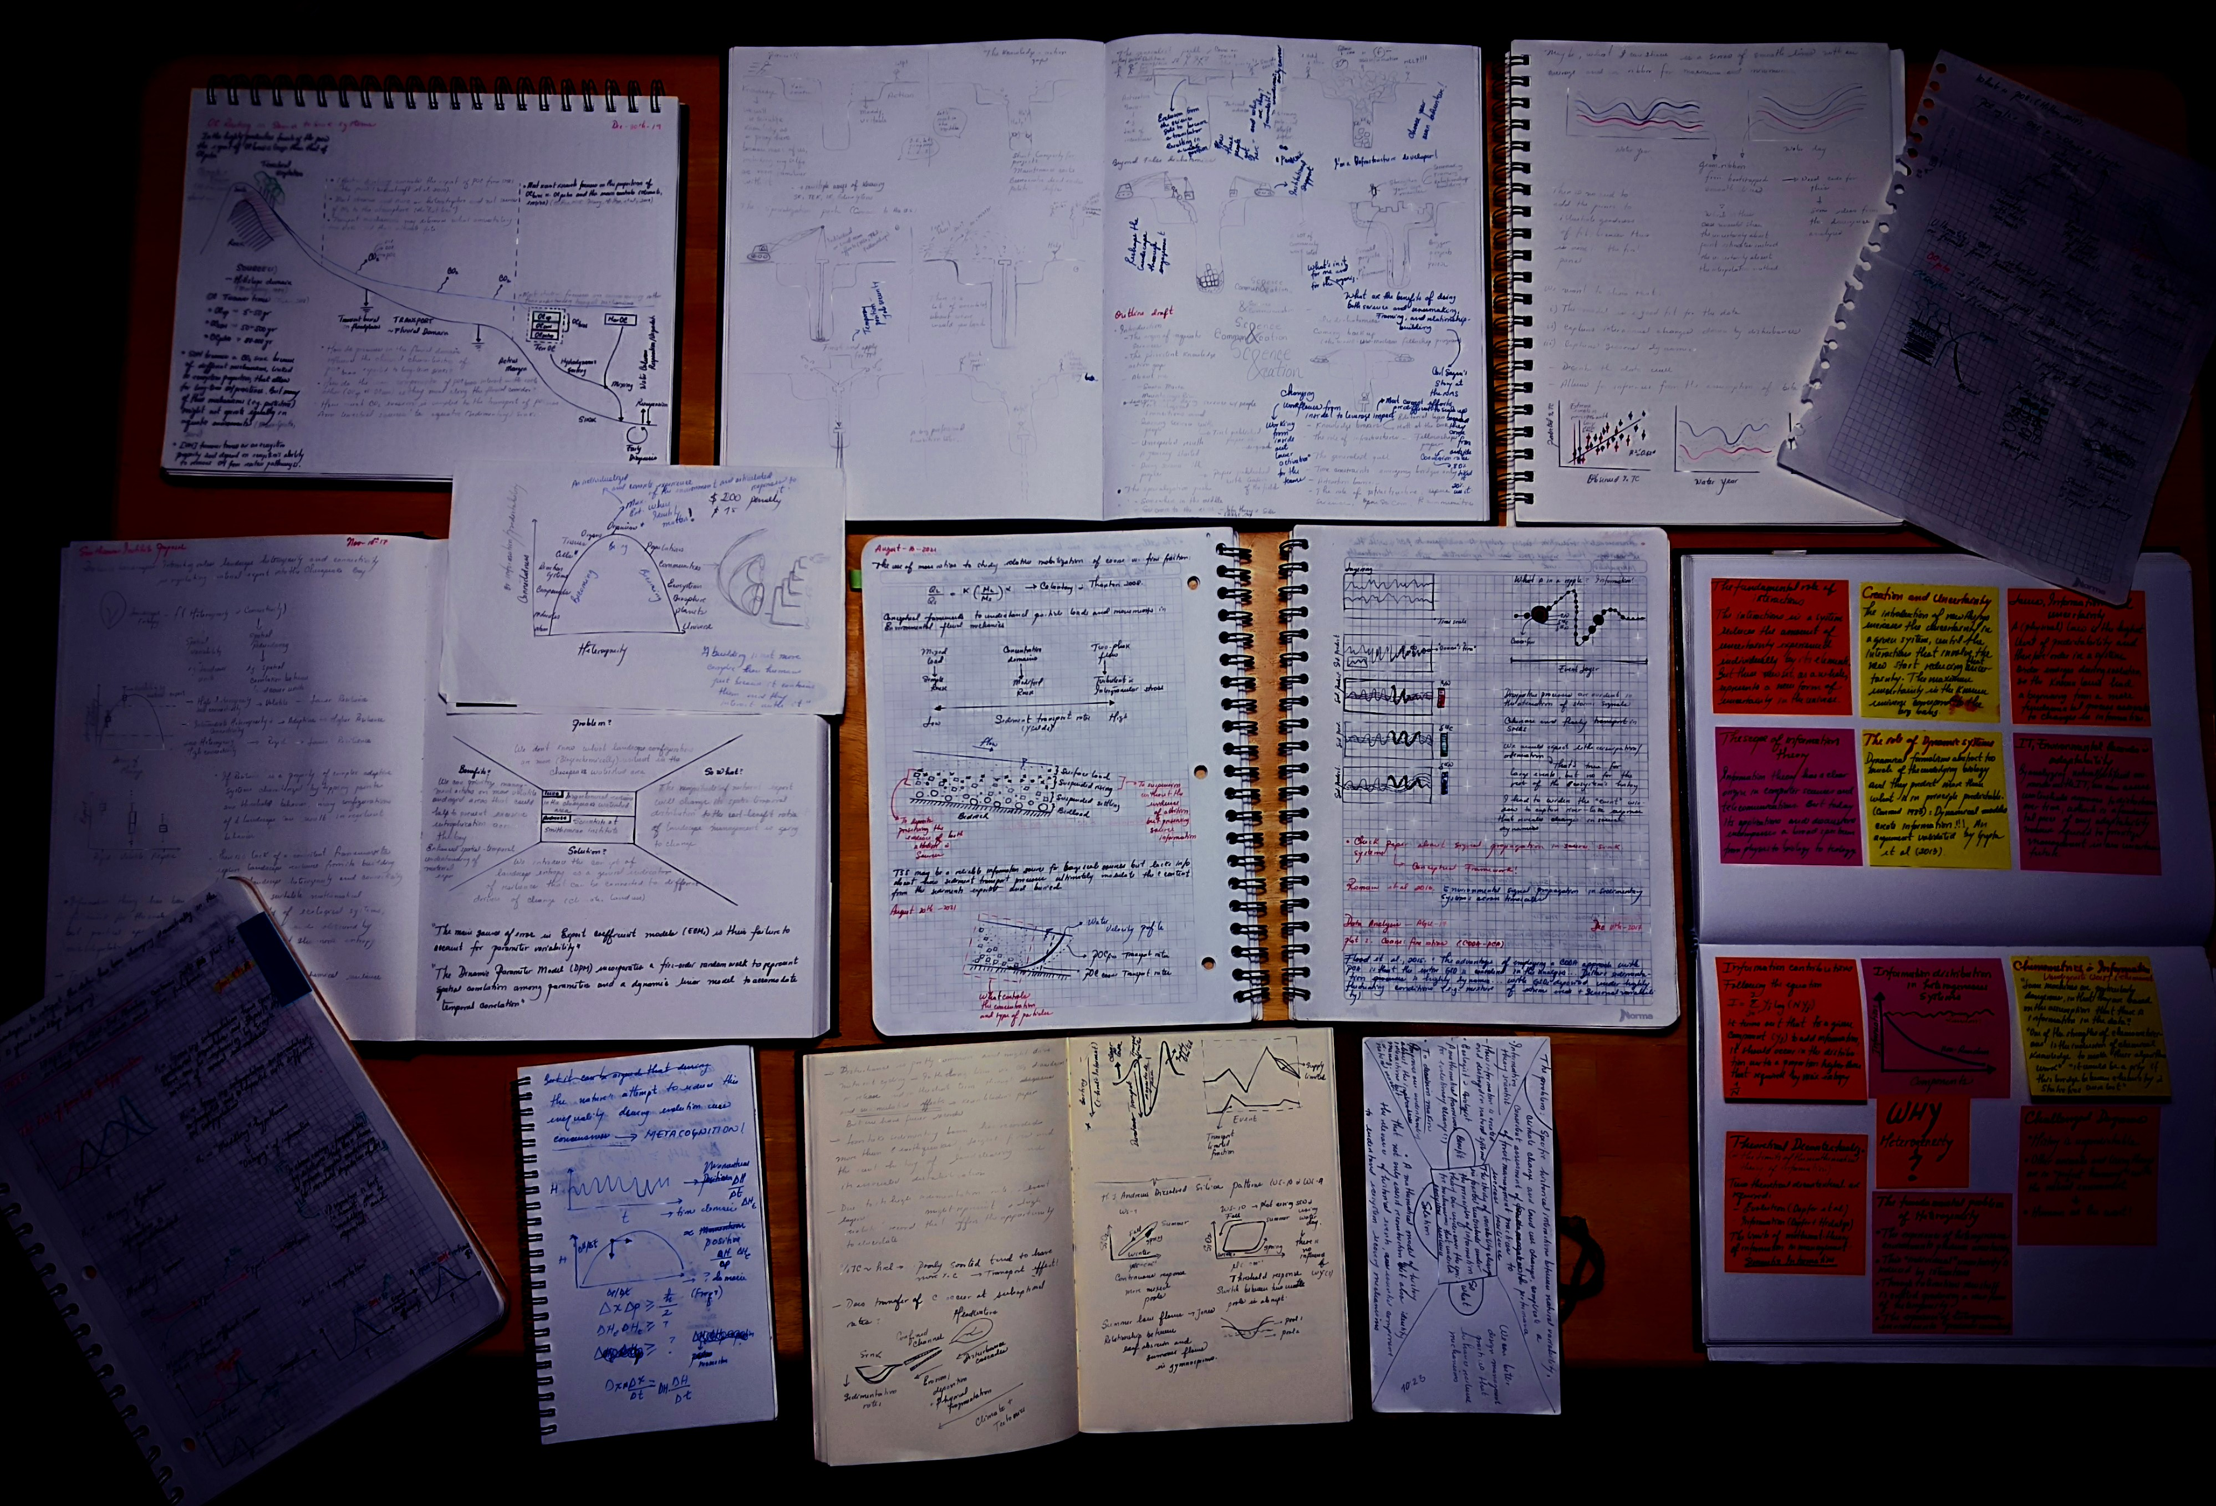
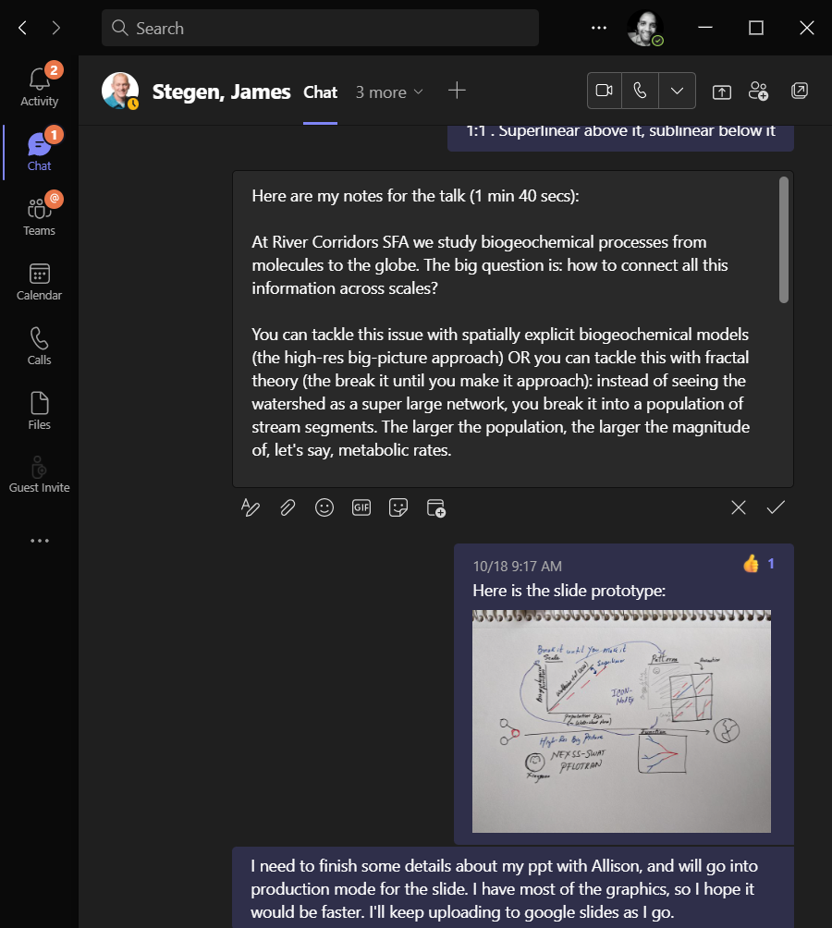


Slide 12
TEXT FACE – Barlow
COLOR PALETTE HEX CODES
Darkest - #0E313A
Dark - #234F5B
Medium - #3A707F
Light - #9ECCC6
Lightest - #CFE5E2
Pink - #FF9E80
Red - #F75848

Slide 13
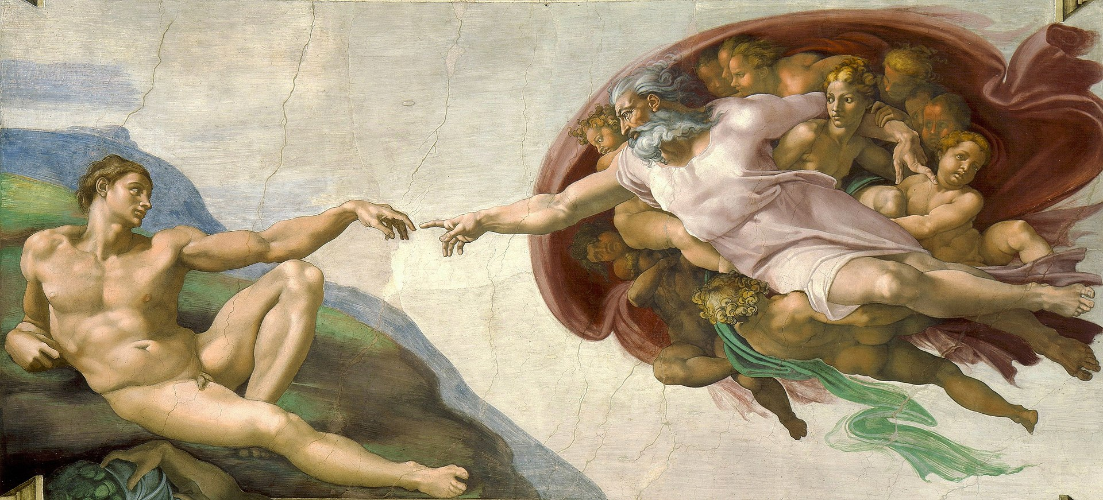
By Michelangelo - See below., Public Domain, https://commons.wikimedia.org/w/index.php?curid=71427942
Notes:
So, where do we start? Perhaps from the very beginning. How do you start creating a data visualization (in its broadest sense): a conceptual figure, a chart, etc.?

Slide 14

Notes:
Creative friction

Slide 15
“I found that the great majority of the men of science […] protested that mental imagery was unknown to them […] they had no more notion of its true nature than a color-blind man who has not discerned his defect...”
— Francis Galton, Statistics of Mental Imagery.
Mind: A Quarterly Review of Psychology and Philosophy | 1880 | https://psychclassics.yorku.ca/Galton/imagery.htm

